Slide 1

Documentation
For Platform-Ops.com
Jeremy Boyle

Slide 2
Links
GitHub link:
https://github.com/Jeremy-Boyle/Platform-ops-final.git
Terraform Documentation For AWS:
https://registry.terraform.io/providers/hashicorp/aws/latest/docs
AWS Documentation:

Slide 3
Prereq
GitHub to download the repo
https://github.com/git-guides/install-git
Terraform
https://learn.hashicorp.com/tutorials/terraform/install-cli
AWS CLI:
https://docs.aws.amazon.com/cli/latest/userguide/install-cliv2.html
Docker:
https://docs.docker.com/get-docker/
Text editor (Preferred Vscode)

Slide 4
What this creates
Network
Subnets
VPC
Security group
ECS Cluster
NGINX
NODEJS
MONGO
POSTGRES
Load-Balancers
PUBLIC
HTTP – HTTPS
Private
MONGO - POSTGRES
Additional
Nagios Server
CloudWatch logs
ECR
Polices
For a full list refer to the source .tf files, each is named with the service it refers to

Slide 5
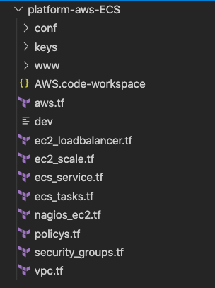
Source Structure
Main configuration options are in AWS.tf
Each file refers to what is inside
For example ec2_loadbalancer is all load balancing related
Conf is the configuration files for our Docker and website live, change as needed but do not change the file names
www is where we place our website files that docker will use to build our nginx image
Keys starts empty but will populate with the generated ssh-keys needed to access the machines if needed.

Slide 6
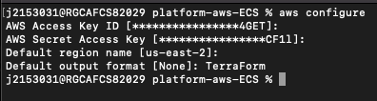
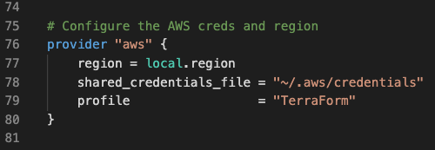
Configuration (AWS Creds)
RUN CMD aws configure
You’ll need your API keys that you create in IAM
Make sure your file matches the correct requirements or change them to your settings

Slide 7
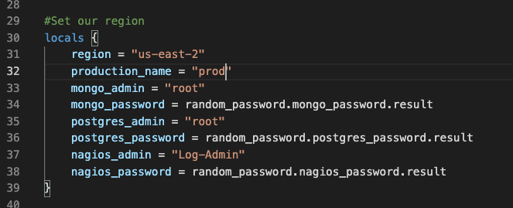
Configuration (Terraform)
Change vars as needed in aws.tf line 30
CMD terraform init
Gets the needed dependencies
CMD terraform plan –out prod
Plans our AWS infrastructure
Run terraform apply “prod”
Creates our instances to AWS

Slide 8
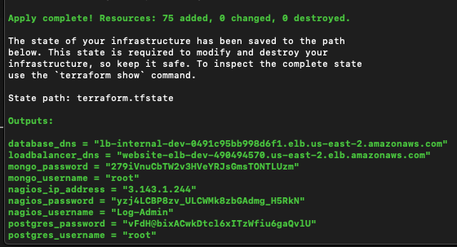
Outputs (Terraform)
CMD terraform output
Shows the configuration options and passwords that it generates
Use these to access the desired resource

Slide 9
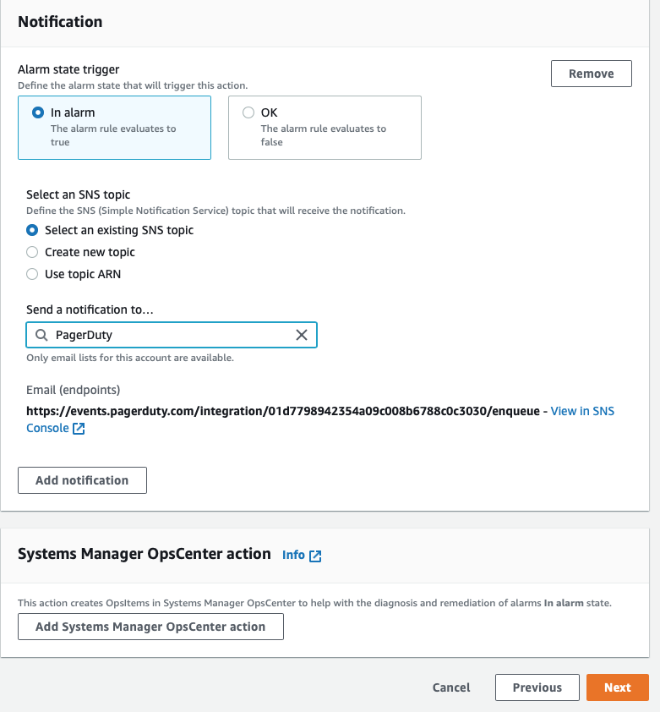
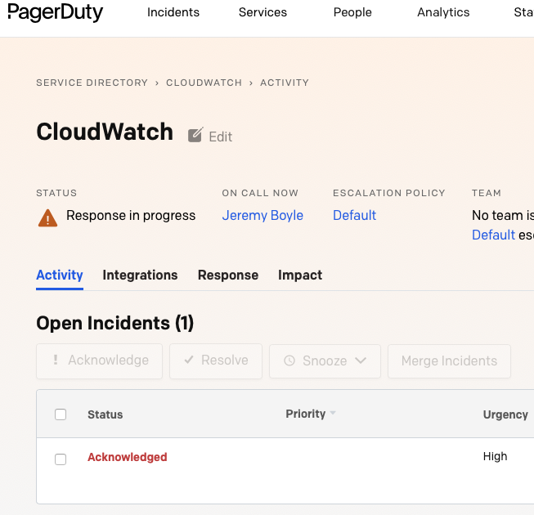
PagerDuty
Optional setup PagerDuty
You can add alerts as need via CloudWatch with alarms
https://docs.aws.amazon.com/AWSEC2/latest/UserGuide/using-cloudwatch-createalarm.html
https://support.pagerduty.com/docs/aws-cloudwatch-integration-guide

Slide 10
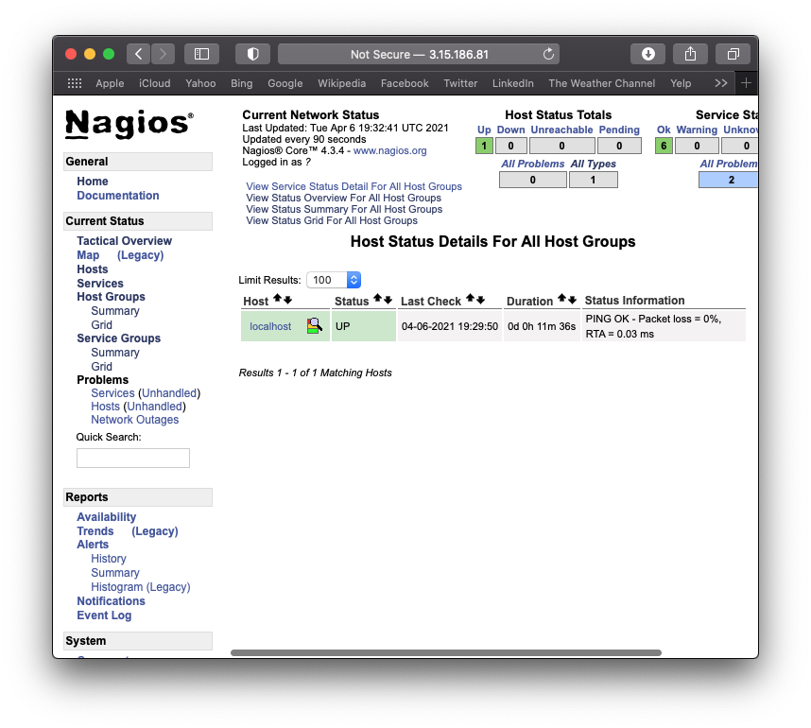
Nagios
Access your Nagios with the provided outputs from terraform

Slide 11
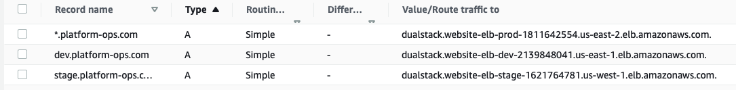
Stages / DNS
Each stage lives in a different region for security
Make sure to route your website to the load balancers
PROD – US-EAST-2 (www.platform-ops.com)
DEV - US-EAST-1(dev.platform-ops.com)
STAGE - US-WEST-1(stage.platform-ops.com)

Slide 12
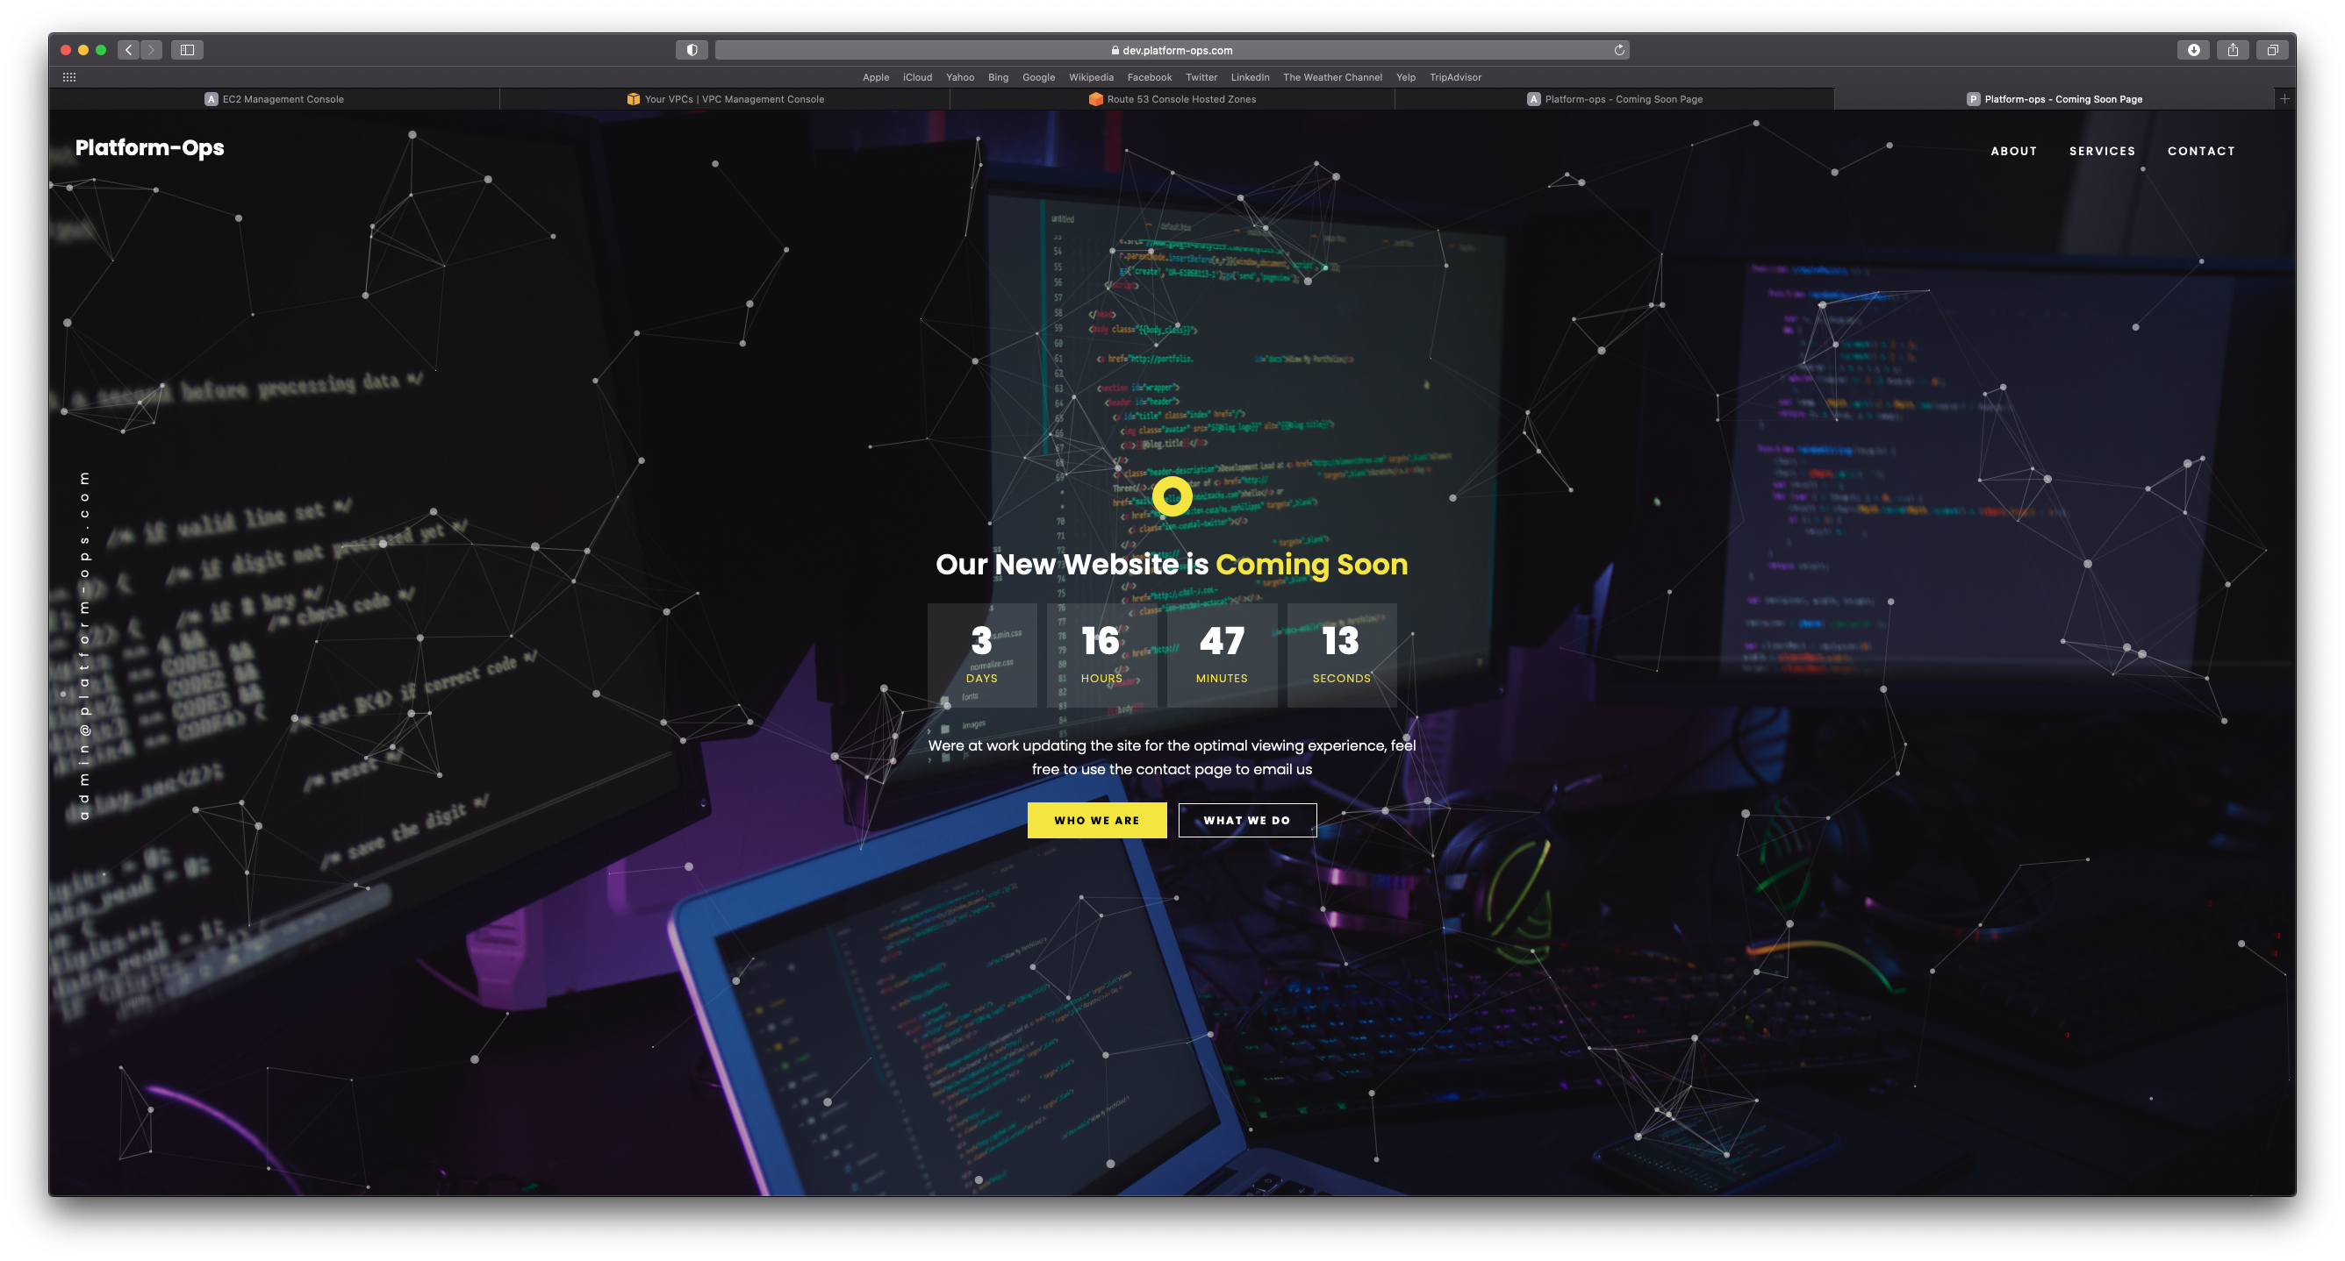
Website platform-ops.com

Slide 13
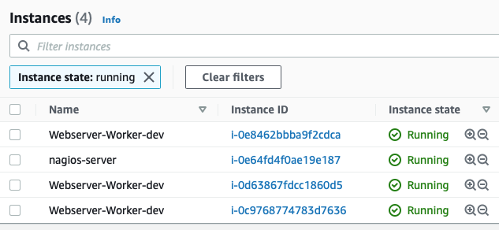
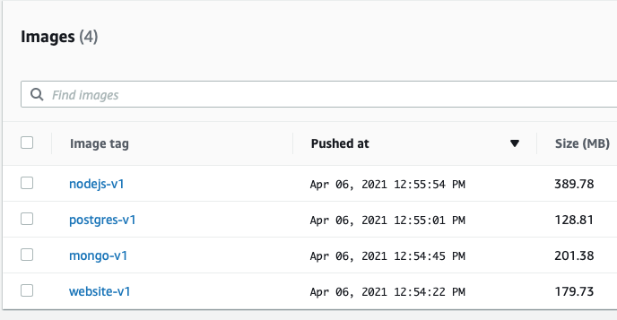
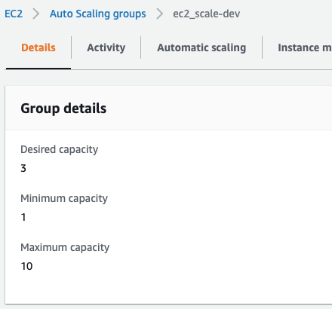
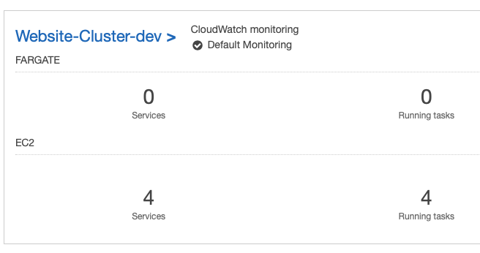
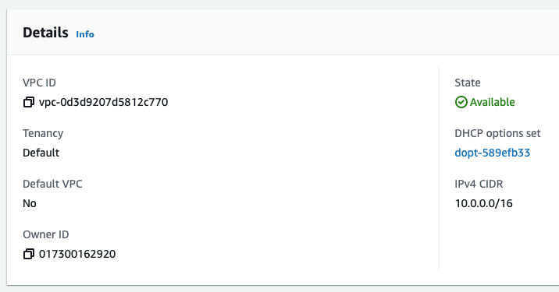
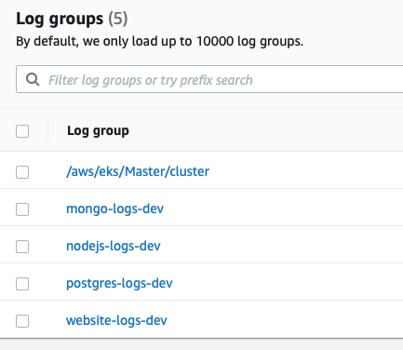
AWS (EXAMPLES)

Slide 14
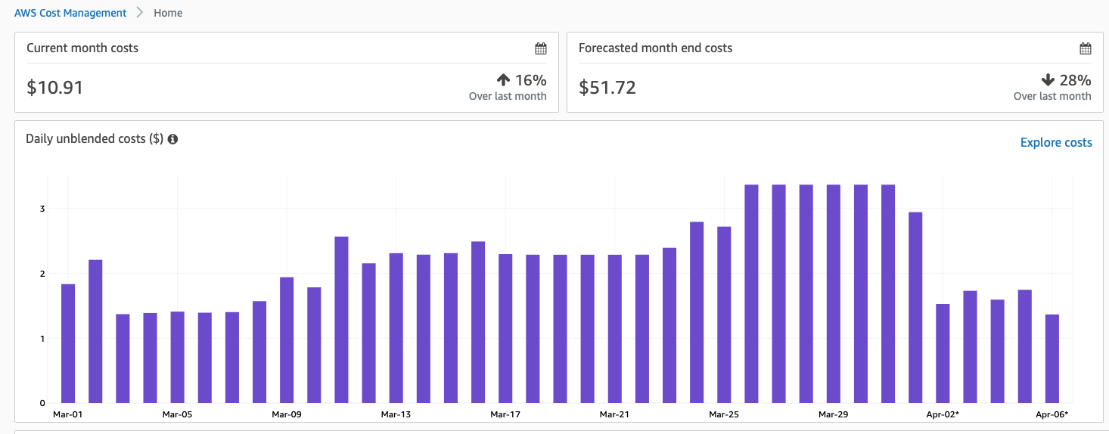
AWS (COSTS)
Estimated cost will change based on usage
MAX instances are set to 10 per auto scaling group for dev / stage / prod
Minimum 6 t3.small instances running at once

